Slide 1


Autoencoder-Based Deep Learning Framework for Network Intrusion and Anomaly Detection
MLA0408 – Deep Learning
Presented by:
HARESH KUMAR N L – 192425009
KUMARAN M - 192525022

Slide 2
ABSTRACT
The increasing use of computer networks has led to a rise in cyberattacks and malicious activities. Traditional Intrusion Detection Systems mainly depend on predefined rules and known attack patterns, which may fail to detect new and previously unseen attacks. This project proposes a Deep Learning-Based Network Intrusion Detection System using Autoencoders for Anomaly Detection. The Autoencoder learns the normal patterns of network traffic from the given dataset. The network data is first cleaned, normalized, and prepared for model training. The trained model reconstructs the input data and calculates the reconstruction error. A suitable threshold is used to distinguish normal traffic from abnormal traffic. High reconstruction error indicates suspicious or potentially malicious network activity. The system is evaluated using Accuracy, Precision, Recall, F1-Score, and Confusion Matrix. The proposed system aims to provide an effective and intelligent solution for detecting network intrusions and improving overall network security.

Slide 3
PROBLEM STATEMENT
The increasing use of computer networks has made them vulnerable to various cyberattacks.
Traditional Intrusion Detection Systems (IDS) mainly depend on predefined rules and known attack signatures.
These systems have limited ability to detect new, unknown, and evolving attacks.
Large volumes of network traffic make manual monitoring difficult and time-consuming.
Therefore, an intelligent system is required to automatically learn normal network behavior.
This project aims to use a Deep Learning-based Autoencoder to identify abnormal network traffic and detect potential intrusions.

Slide 4
EXISTING SYSTEM & PROPOSED SOLUTION
Existing System
Relies on predefined rules and attack signatures.
Mainly detects known attacks.
Requires frequent rule and signature updates.
Has limited ability to detect new and evolving threats.
Manual monitoring of large network traffic is time-consuming.
Provides limited real-time analysis and visualization.
Proposed Solution
Uses a Deep Learning-based Autoencoder for intrusion detection.
Learns normal network behavior automatically.
Detects unknown and anomalous network traffic.
Uses Reconstruction Error (MSE) for anomaly detection.
Automatically determines an Anomaly Threshold for classification.
Provides a real-time dashboard for traffic, threats, and model monitoring.

Slide 5
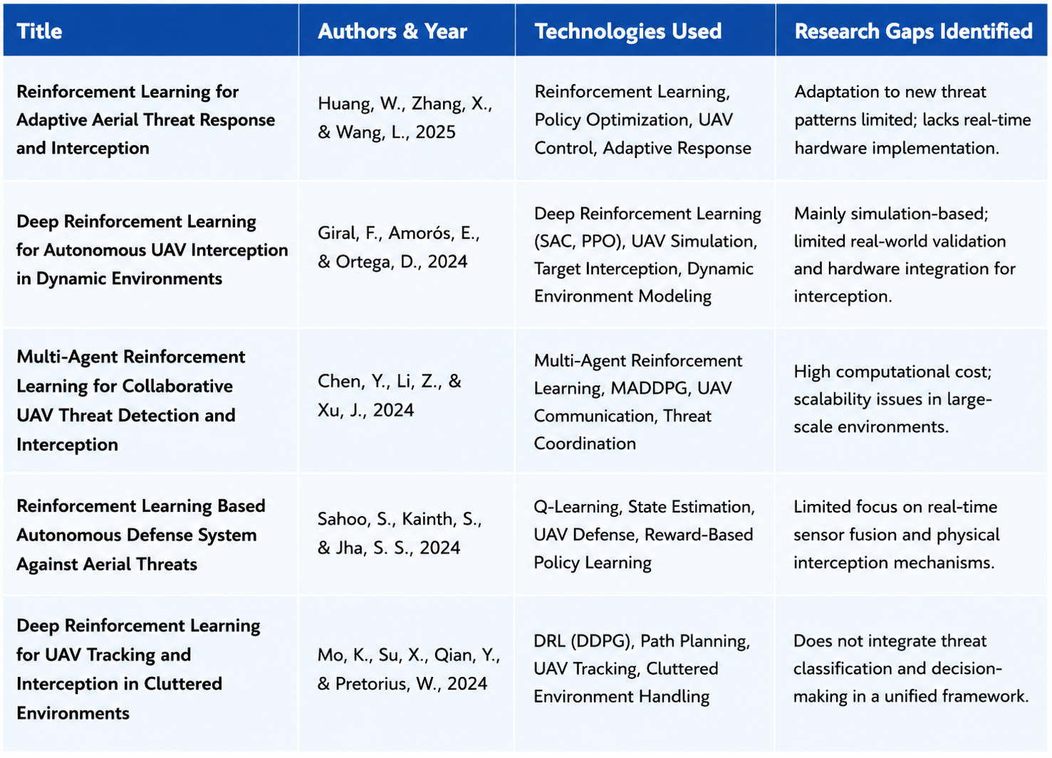
LITERATURE REVIEW

Slide 6
TECHNOLOGIES USED
HARDWARE
Component | Specification
Processor | AMD Ryzen 5 7520U
RAM | 16 GB
Graphics | AMD Radeon Graphics
Storage | 477 GB
OS | Windows 11
SOFTWARE
Software | Technology
Programming | Python
Deep Learning | TensorFlow / Keras
Data Processing | Pandas, NumPy
Backend | FastAPI
Frontend | React.js, TypeScript
Dataset | NSL-KDD
Deployment | GitHub Pages, Render

Slide 7
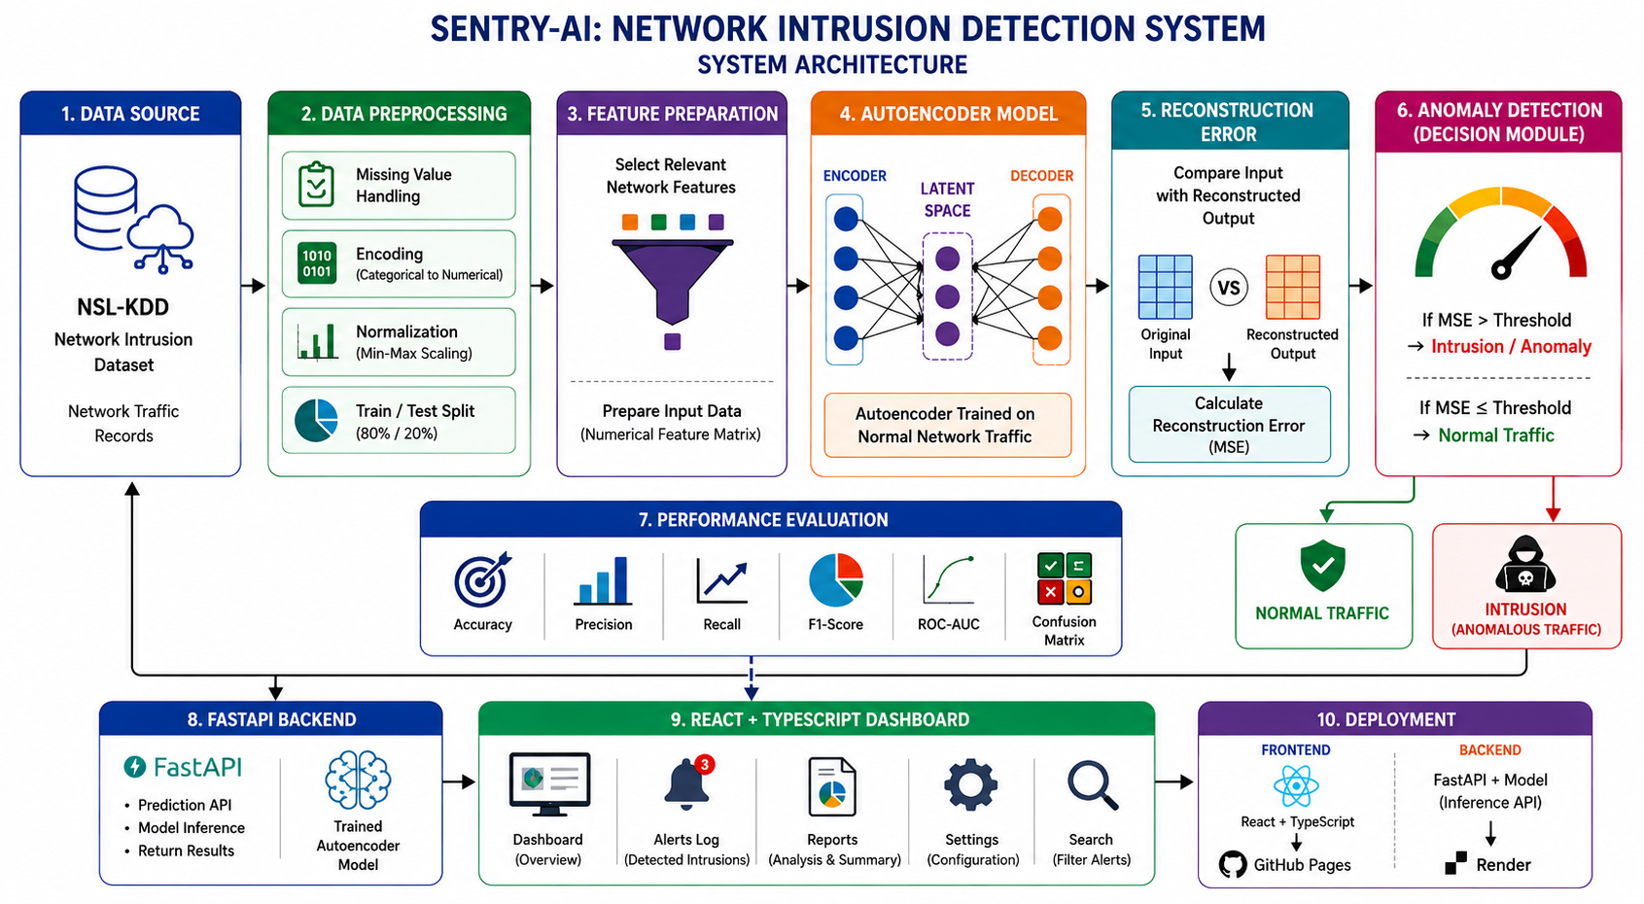
ARCHITECTURE DIAGRAM

Slide 8
Module 1
DATA COLLECTION AND PREPROCESSING
Objective
To collect network traffic data and prepare it for training the Autoencoder model.
Activities
Collect the NSL-KDD network intrusion dataset.
Identify normal and attack network traffic.
Handle missing and duplicate data.
Convert categorical features into numerical values.
Normalize numerical features using Scikit-learn.
Select relevant network traffic features.
Split the dataset into training and testing data.
Output: Clean and normalized network dataset ready for Autoencoder training.

Slide 9
Module 2
AUTOENCODER MODEL DEVELOPMENT
Objective
To develop and train a Deep Learning Autoencoder that learns the patterns of normal network traffic.
Activities
Design the Autoencoder architecture.
Use Encoder → Bottleneck → Decoder layers.
Train the model primarily using normal network traffic.
Use ReLU activation in hidden layers.
Use Adam optimizer for training.
Use Mean Squared Error (MSE) as the reconstruction loss.
Save the trained model for future predictions.
Output: A trained Autoencoder capable of reconstructing normal network traffic.

Slide 10
Module 3
ANOMALY DETECTION AND PERFORMANCE EVALUATION
Objective
To identify abnormal network traffic and evaluate the performance of the trained model.
Activities
Input network traffic into the trained Autoencoder.
Compare original and reconstructed data.
Calculate the Reconstruction Error (MSE).
Calculate an anomaly threshold from normal validation data.
Classify traffic as Normal or Intrusion.
Generate a Confusion Matrix.
Calculate Accuracy, Precision, Recall, F1-Score and ROC-AUC.
Output: Detection of suspicious network activities with measured modelerformance.

Slide 11
Module 4
SYSTEM DEPLOYMENT AND VISUALIZATION
Objective
To integrate the trained model with a web-based dashboard for monitoring and visualization.
Activities
Develop the backend using FastAPI.
Connect the Autoencoder model with the prediction API.
Develop an interactive dashboard using React and TypeScript.
Display network traffic and reconstruction errors.
Show detected intrusions and alert information.
Provide reports and performance metrics.
Deploy the frontend using GitHub Pages.
Deploy the backend using Render.
Output: A web-based Network Intrusion Detection System for real-time monitoring.

Slide 12
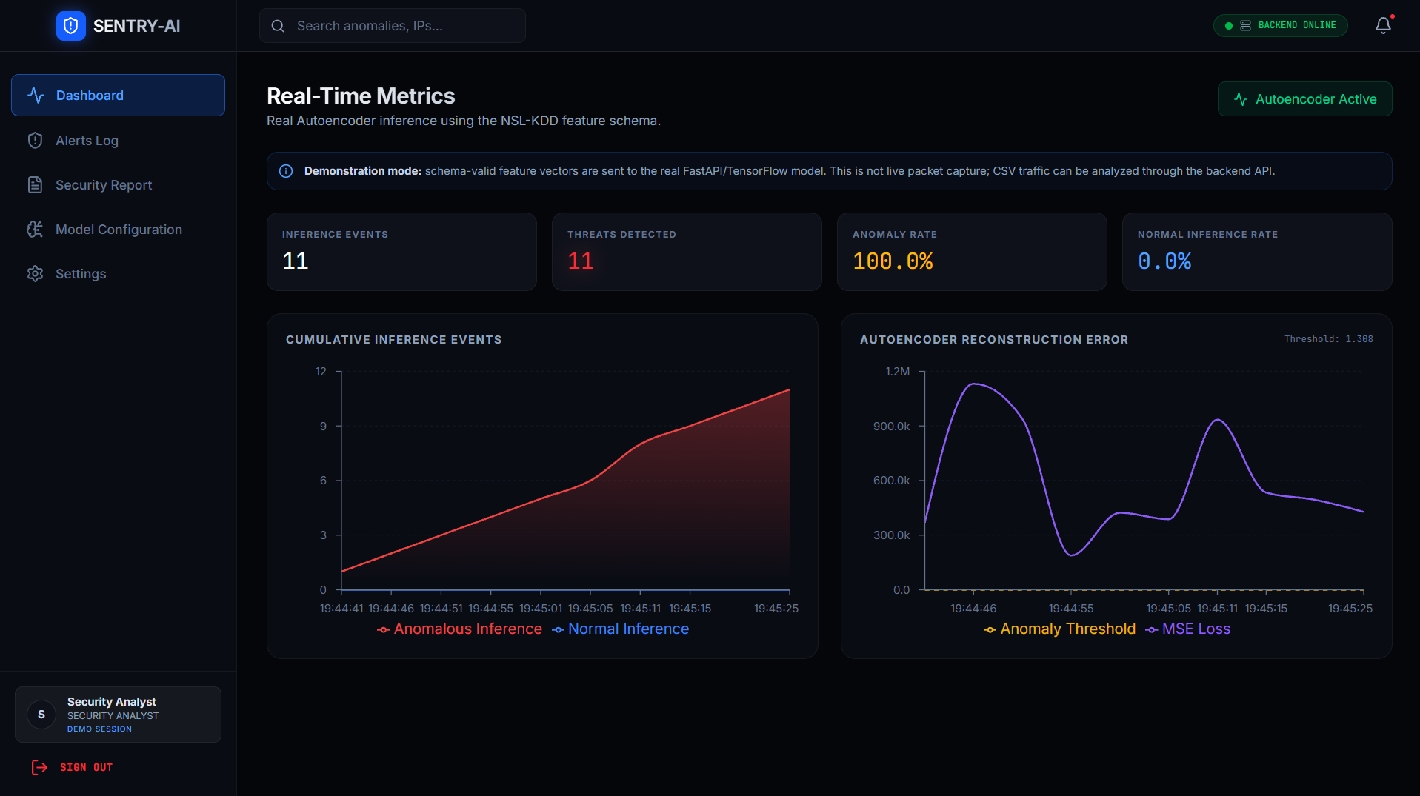
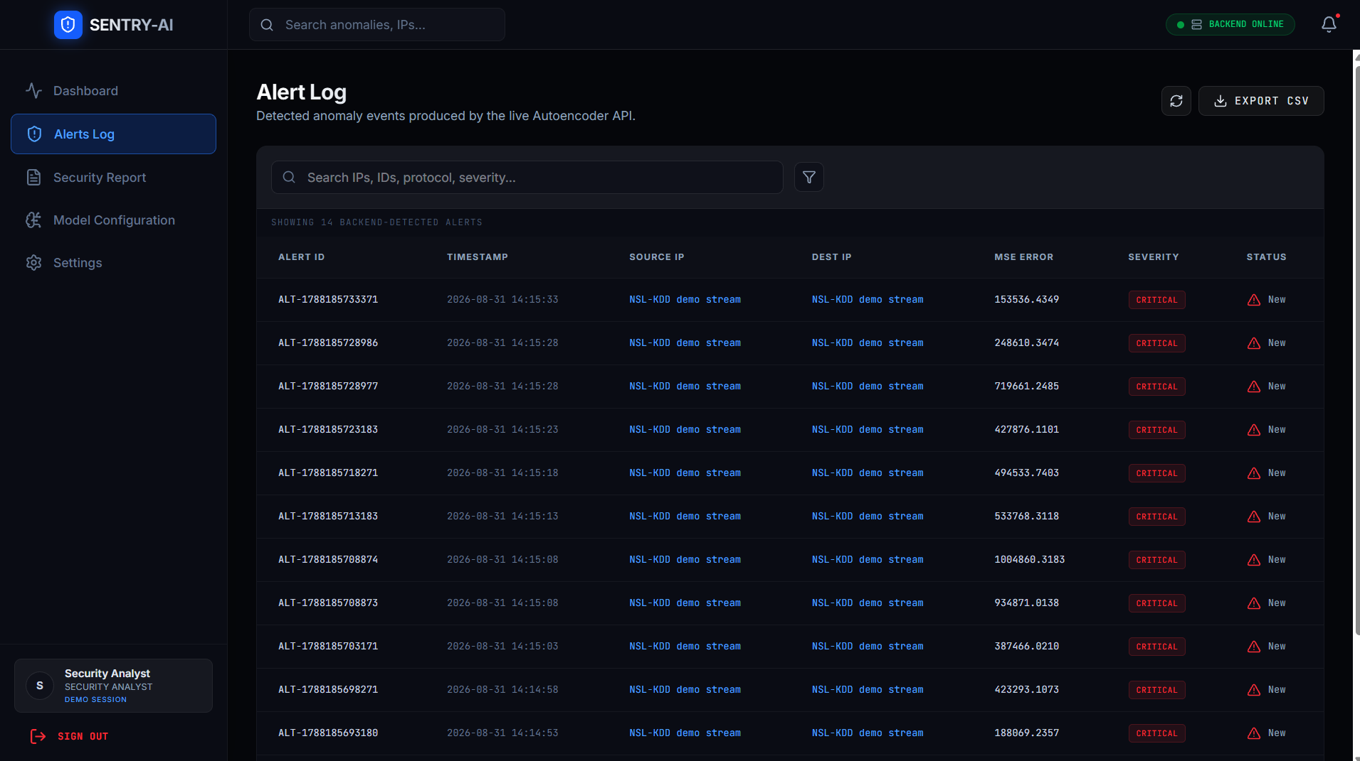
IMPLEMENTATION

Slide 13
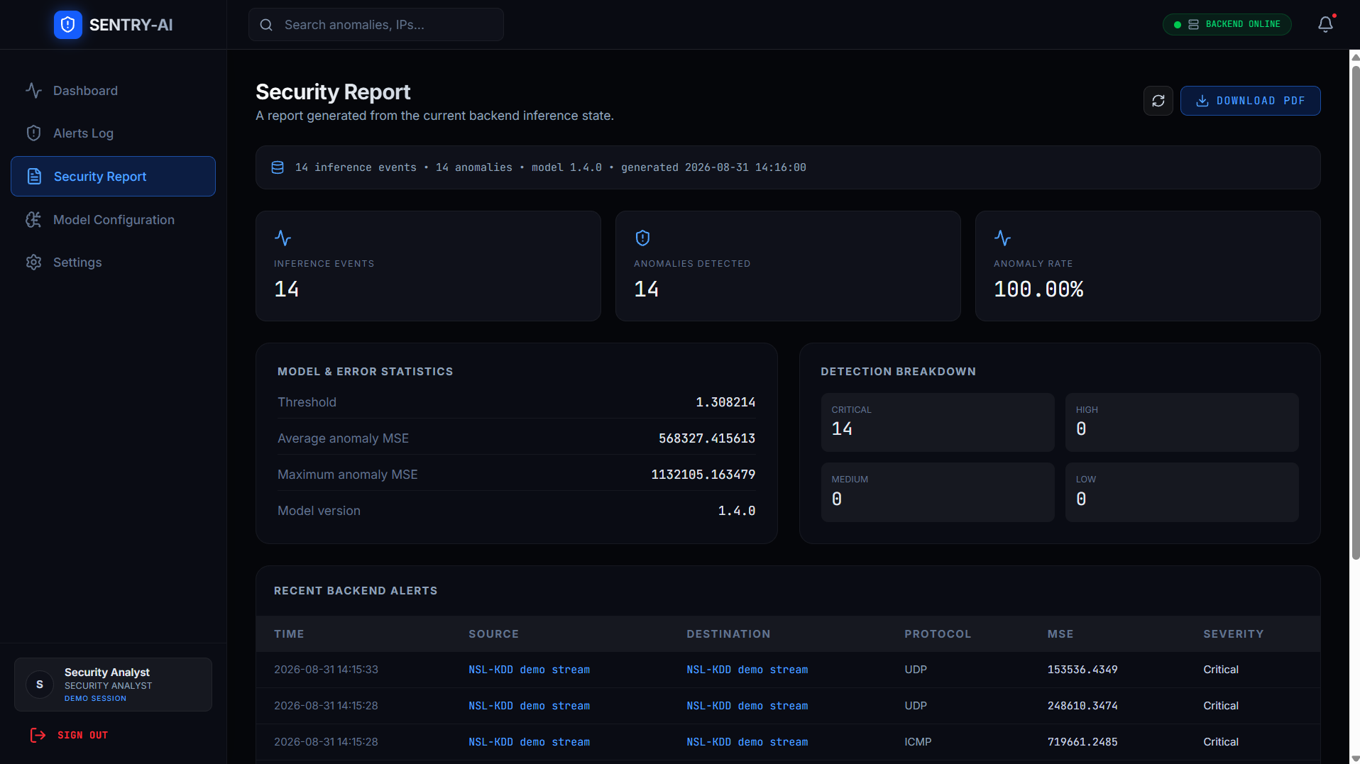
IMPLEMENTATION

Slide 14
RESULT & DISCUSSION
The autoencoder successfully learned the patterns of normal network traffic from the NSL-KDD dataset.
The model generated reconstruction error (MSE) values for network records, allowing normal and abnormal patterns to be distinguished.
The anomaly threshold provided a decision boundary for identifying traffic with unusually high reconstruction errors.
The web dashboard displayed the detected network activity through graphs, statistics, alerts, and model information, making the results easier to interpret.
The Alerts Log and Reports presented important detection information such as severity, source and destination details, protocol, MSE, and detection time.
The results indicate that combining autoencoder-based detection with a web-based monitoring system provides a practical approach for analyzing network anomalies.

Slide 15
SDG GOLAS
SDG 9 – Industry, Innovation and Infrastructure: Uses deep learning and AI technology to develop an innovative network security system.
SDG 16 – Peace, Justice and Strong Institutions: Improves cybersecurity by detecting network threats and supporting secure digital infrastructure.
SDG 8 – Decent Work and Economic Growth: Helps organizations reduce the impact of cyberattacks and maintain reliable digital services.
SDG 4 – Quality Education: Demonstrates the practical application of machine learning and cybersecurity concepts for educational and research purposes.
SDG 17 – Partnerships for the Goals: Provides a technology framework that can support collaboration between cybersecurity teams, organizations, and technology platforms.

Slide 16
CONCLUSION
The project successfully developed, an integrated framework for detecting network intrusions using deep learning.
The proposed system provides a complete workflow from data preprocessing and model training to anomaly detection and security monitoring.
The system reduces the need for manual analysis by automatically identifying traffic that differs significantly from learned normal behavior.
The modular architecture allows the system to be maintained, retrained, and extended with additional datasets and detection techniques.
The project provides a strong foundation for future integration with real-time network traffic, packet capture, and enterprise security infrastructure.
Overall,demonstrates the potential of deep learning-based anomaly detection as an effective cybersecurity solution.

Slide 17
FUTURE SCOPE
Real-Time Network Monitoring: Integrate live packet capture and network traffic monitoring for continuous intrusion detection.
Advanced Deep Learning Models: Extend the system using LSTM, CNN, Transformer, or hybrid models to improve detection performance.
Larger and Updated Datasets: Train the model using modern cybersecurity datasets containing current attack patterns.
Automated Threat Response: Add automatic actions such as blocking suspicious IP addresses and generating security notifications.
Cloud and Enterprise Integration: Deploy the system with cloud infrastructure and integrate it with SIEM and other security platforms.
Continuous Model Learning: Implement periodic retraining and adaptive learning so the model can recognize newly emerging attack patterns.

Slide 18
REFERENCES
G. E. Hinton and R. R. Salakhutdinov, “Reducing the Dimensionality of Data with Neural Networks,” Science, vol. 313, no. 5786, pp. 504–507, 2006.
Y. LeCun, Y. Bengio, and G. Hinton, “Deep Learning,” Nature, vol. 521, no. 7553, pp. 436–444, 2015.
M. Tavallaee, E. Bagheri, W. Lu, and A. A. Ghorbani, “A Detailed Analysis of the KDD CUP 99 Data Set,” Proceedings of the IEEE Symposium on Computational Intelligence for Security and Defense Applications (CISDA), 2009.
I. Sharafaldin, A. H. Lashkari, and A. A. Ghorbani, “Toward Generating a New Intrusion Detection Dataset and Intrusion Traffic Characterization,” Proceedings of ICISSP, pp. 108–116, 2018.
A. H. Lashkari, G. D. Gil, M. S. I. Mamun, and A. A. Ghorbani, “Characterization of Tor Traffic Using Time-Based Features,” Proceedings of ICISSP, 2017.
J. An and S. Cho, “Variational Autoencoder Based Anomaly Detection Using Reconstruction Probability,” Special Lecture on IE, vol. 2, no. 1, 2015.
T. N. Kipf and M. Welling, “Semi-Supervised Classification with Graph Convolutional Networks,” arXiv preprint arXiv:1609.02907, 2017.

Slide 19
Thank You!

